Slide 1
Idea/Project Details
Organization : Yamaha Motor Solution India Pvt. Ltd
Problem Statement : Mobile game for Alzheimer’s disease detection
Problem Statement Code : DK287
Team Name : Sic Mundus
Team Leader Name : Shaik Idrisulla
College Code : MGIT
Solution/Prototype
Problem faced : Early detection of Alzheimer’s and its symptoms, which can be severe at later stages of the disease.
Basic Intention : Detection of Alzheimer’s disease at an early stage prior to the involvement of a doctor through a mobile game.
Functions : To make the user go through a series of tests to analyse their capabilities and give a detailed report.
Works on : Any smartphone with a SIM card and Internet connectivity.
Supplements : Gives a detailed report and lets the user know their stats.
Notes:
1/21/2020
1
1

Slide 2
Technology Stack
Languages used : Java,C#
Database : SQLite
Operating System : Windows
Hardware Requirements : Smartphone,PC
Software Requirements : Android 5.1 and above
Front-End Development Tools : HTML,XML,CSS,Adobe Illustrator.
Back-End Servers : SQLite Database with Android Studio.
Notes:
1/21/2020
2
2

Slide 3
An Overview of the Application
How to play
Tutorial
What to expect
Basic UI
functions
User
Quick play
Basic Memory Test
Sign-up
Cognitive test
Language Assessment
Simple
puzzles
Number Assessment
IQ Test
Number
Series
Personal info test
provided in survey
SQLite
Database
Number
Assessment
About
Game version and
Other details
Report generation
Notes:
1/21/2020
3
3

Slide 4
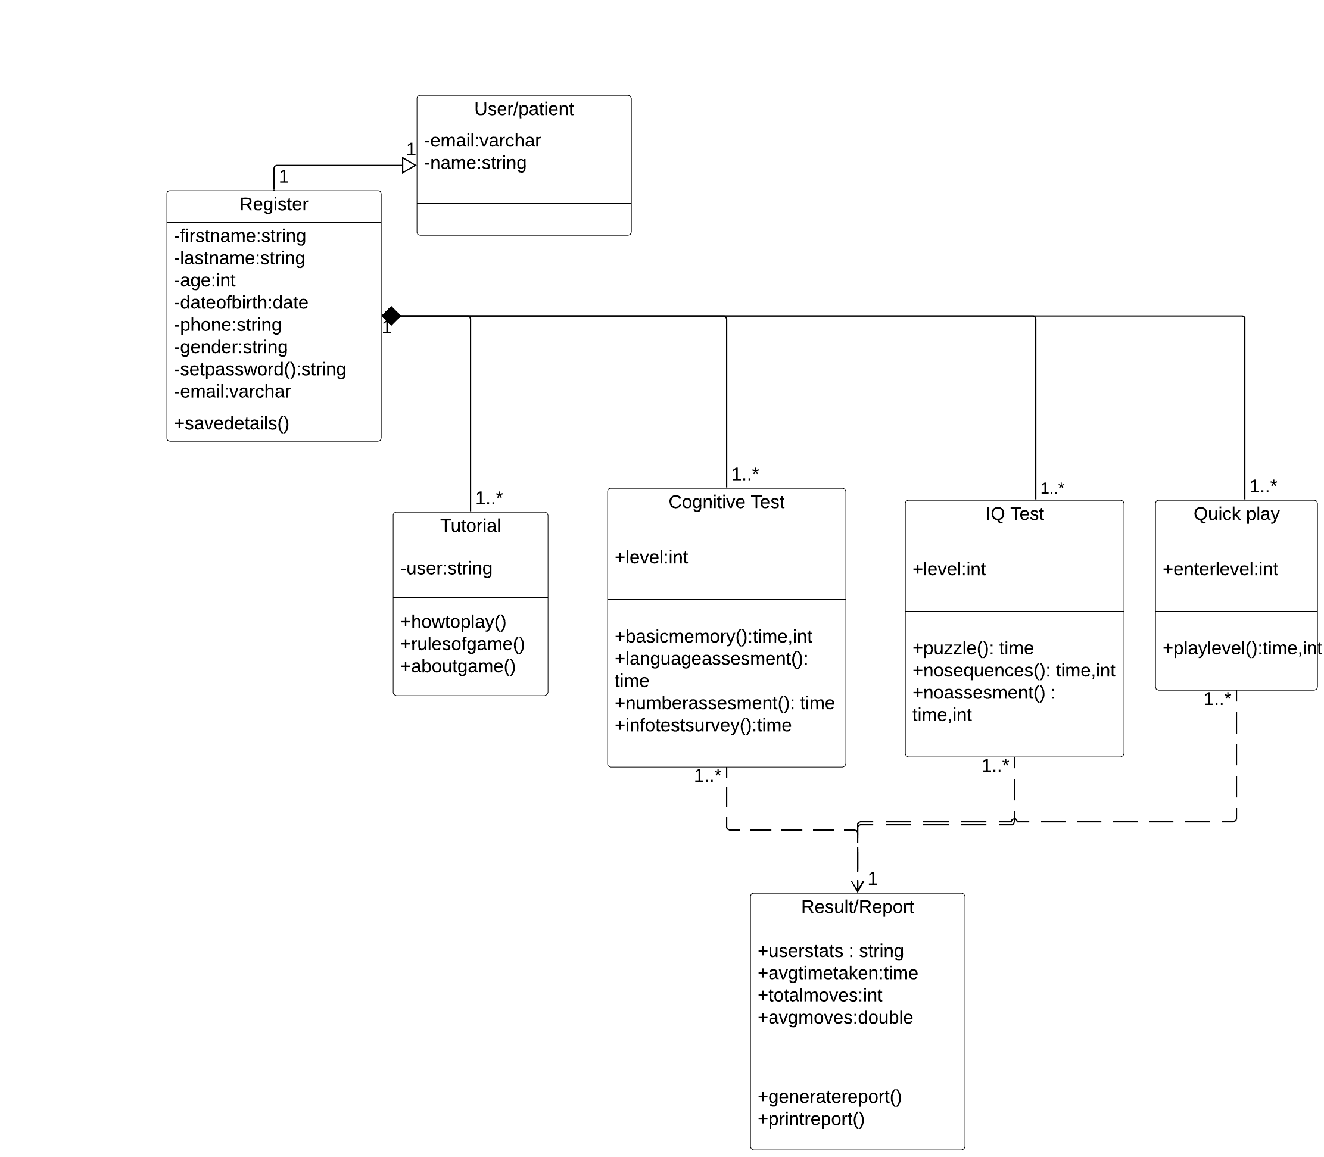
UML Diagram

Slide 5
Dependencies
S.No | Dependency | Result
1. | More number of users required. | For generating an accurate report.
2. | Further medical testing of the user. | For examining the mental and physical behaviour of the user.
3. | Need of a qualified physicist. | For examining the report based on the user’s performance.
Notes:
1/21/2020
5
5

